Slide 1
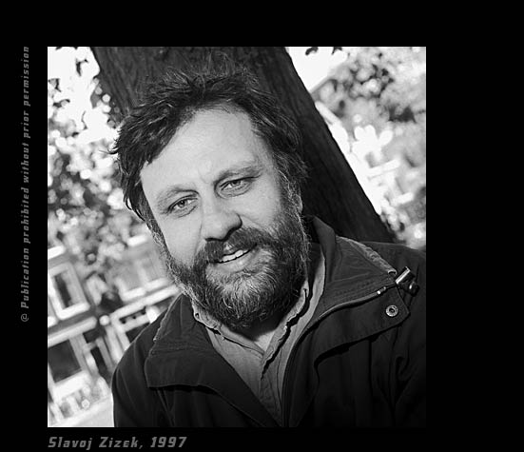
Lecture Four: Zizek

Slide 2
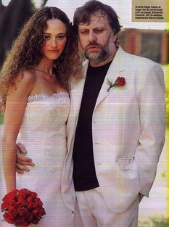

Slide 3
Ideology: cynical obedience
The ‘post-ideological age’ only signifies the triumph and universalisation of neo-liberal ideology.
Zizek reasserts the old problematic of ideology – ideology is still with us, but functions in a different way.
Zizek rejects the Marxist ‘false consciousness’ thesis: ideology today no longer functions through deluding the subject, but rather in an entirely cynical way. In other words, we do not have to believe in the truth of the ideological message, as long as we act as though we believe – as long as we obey at the level of our every actions
Materialist understanding of ideology – no longer a matter of conscious belief, but everyday material practices which sustain existing system (eg consumerism). Formula is no longer: ‘They do not know it but they are doing it’, but rather ‘They know it, but they are doing it anyway’.
Relies on a split in the subject between his conscious and unconscious selves: at the conscious level we can be entirely cynical about the ideological message, but we still have an unconscious attachment to it, which we articulate through everyday practices.
Ideology relies on a cynical distance between the subject and the message. Therefore what really threatens the consistency of ideology is not cynical disbelief, but perhaps the opposite -sincere, naïve belief, total identification with the overt message.
.

Slide 4

Action without belief: buying the ideological ‘product’

Slide 5
Function of ideology: masking social trauma
The function of ideology is to hide or mask social trauma – to obscure the dislocation at the heart of social representation (Lacan’s Real). Ideology presents a coherent, stable picture of society – it allows the subject to conceptualise the whole and situate themselves within it.
Ideology contains a fantasy of a harmonious, stable society without dislocation and antagonism. It achieves this by blaming social dislocation on a certain figure of the enemy (the Jew, the bourgeois ‘class traitor’, the immigrant, the terrorist) whose elimination will restore harmony to society. This harmony is always imaginary and ultimately impossible.
What is peculiar about ideology is the logical inconsistency of its elements – eg idea of ‘Jewish-capitalist-Bolshevik conspiracy’ in Nazi ideology – which nevertheless do not weaken the hold that ideology has over its subjects.
In attempting to repress social trauma, ideology also reveals it as its true point of reference. Its hidden unconscious truth becomes externalised.

Slide 6
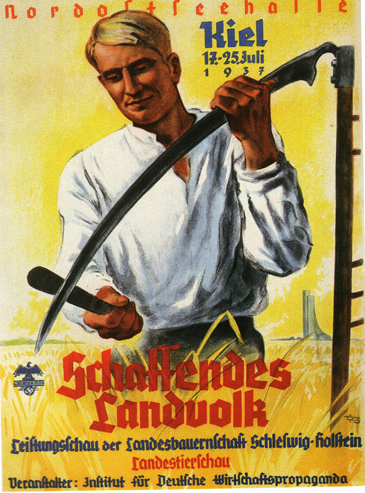
The fantasy of harmonious community in Nazi ideology

Slide 7

The figure of the Jew in Nazi ideology

Slide 8
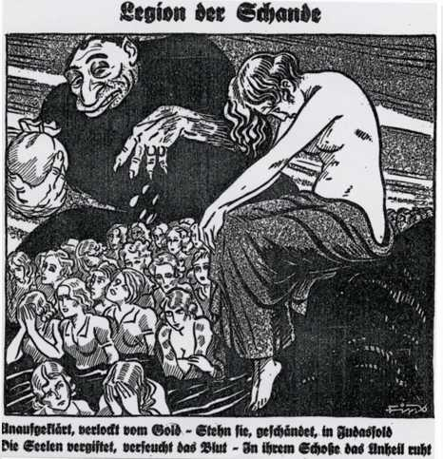
The figure of the Jew in Nazi ideology

Slide 9
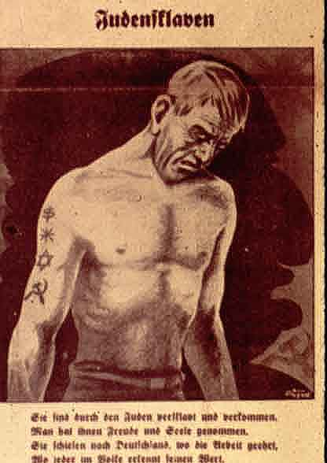
The inconsistent elements of ideology

Slide 10
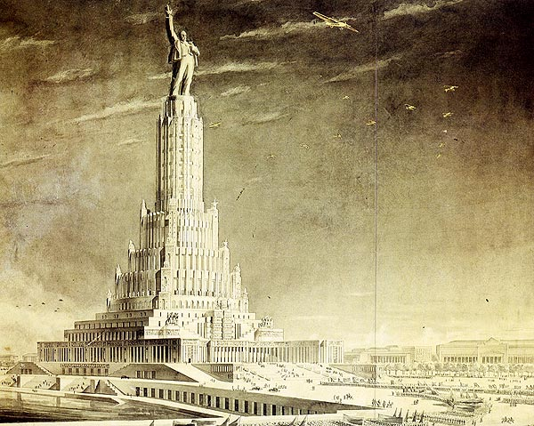
The unconscious truth of ideology

Slide 11
Transgression and the Law
There is a symbiotic relationship between transgression and the Law today. Rather than the Law prohibiting, saying ‘no’ to enjoyment (as in the old paternal voice of the superego Father) the law now permits you (expects you) to enjoy, and to transgress authority (at least within certain limits). The voice of the Master is no longer one of prohibition but one of commanded enjoyment, and an invitation to violate the rules.
Lacan’s notion of the ‘decline of the paternal function’ in the modern period doesn’t mean more freedom, but rather the emergence of new and ‘perverse’ forms of authority. These permit and indeed encourage enjoyment, perversion and a certain violation of the formal rules, but this merely reinforces social authority and internal prohibition. (Lacan: ‘when God is dead everything is forbidden’).
We now live in a society of commanded enjoyment and more informal authority: have fun, be rebellious, question authority! – eg Enjoy Coke!; horizontal structure of modern capitalist workplace. But there is nothing liberating about this – there is a more veiled and coded message of obedience.
The structure of the Law contains within it its own transgression. The Law relies not so much on overt commandments but rather on unwritten, informal rules.
So once again, perhaps the most effective form of resistance might be to overidentify with and adhere to the very letter of the law

Slide 12

The society of enjoyment

Slide 13
Critique of liberal multiculturalism
Liberal multiculturalism functions today as the main ideological support for globalised capitalism. Ideas of pluralism, tolerance and ‘respect’ for difference (cultural, ethnic, religious, sexual), and anti-discrimination have become the official ideology. These ideas do little to challenge the economic structures of capitalism.
Liberal multiculturalism is a sign of the Left’s capitulation to neo-liberal global capitalism – pseudo politics. The strongest political challenge to global capitalism has come in recent years from the populist Far Right, albeit in a perverted racist form. The Left must retake this ground.
Current cultural wars between Left and Right over issues such as gay marriage and multiculturalism are a displacement for class struggle.
Tolerance and the ‘respect for difference’ is really a veiled contempt for the other – respecting the other’s difference is a way of keeping him at a distance
  Patronising fascination for the cultural practices and traditions of the other – we see the other through a fantasy frame of liberal neutrality, which is really one of veiled superiority.
Strange ambivalence of liberal multiculturalism
  We tolerate all sorts of serious human rights abuses for fear of not wanting to impose our values on the other (say in China), but at the same time there’s certain practices that we won’t tolerate – like violence against women (associated with cultures we regard as ‘fundamentalist’ and ‘barbaric’)
Political Correctness
  Has become official institutionalised discourse –involves obsessive policing of language, thought and action
  Conceals a contempt for those marginal identities it seems to protect
  Based on a kind of victim ideology – idea of sexual harassment always positions women as the helpless victims of male sexual desire.

Slide 14

Obsession with harassment

Slide 15
The liberal utopia
Liberalism has always seen itself as non-utopian - claims to embrace pluralism, difference and limited, rather than universal, perspectives; realism rather than moral and political idealism – private vices produce public virtues.
Leads to ideal of universal liberal market, where cultural difference is tolerated, provided people do not harm one another and human rights are respected.
But behind this lurks a kind repressive moralism, and a new totalitarianism of rules and laws designed to prevent discrimination and harassment.
In the absence of coherent customs and traditions, who decides what is harassment, who is harassing whom?
  Arbitrary character of these new rules about harassment – eg those who argue for legalisation of soft drugs also argue for the restriction of smoking
Liberals impose their own PC view of the world, which is equally utopian: that is, they judge the entire world from their own perspective of respect for difference; there is nothing neutral about respect for difference, it obscures its own universality and dogmatic qualities.
Crucial for the left to retake the cultural terrain from the Right, to drop its formal stance of ‘neutrality’, and to reinvent for itself a kind of ‘culture’: a series of ethical and moral standards which can be applied universally (related to secularism, modernity, liberty and equality)

Slide 16
Welcome to the Desert of the Real: 9/11 and the power of the spectacle
The visual and symbolic impact of 9/11 was much more powerful than its physical impact
The compulsion to repeat the spectacle – element of fascination, voyeuristic enjoyment.
  we were confronted with an event that shook us out of our insipid, sanitised, virtualised lives
Uncanny quality of the images – like a Hollywood movie coming to life
  Indicates that this spectacle of destruction and major symbolic event was something that we had been fantasising about, a fantasy articulated at the level of popular culture.
  Fantasies of destruction and catastrophe
  Thanatos – drive towards death and destruction at the heart of civilisation (Freud)

Slide 17
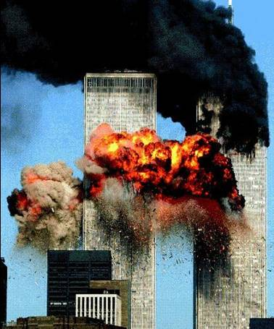
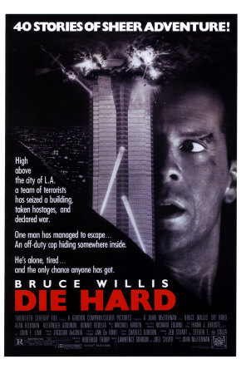
The fantasy of destruction

Slide 18

9/11 and the passion of fundamentalism
What does terrorism say about our society and about ourselves as subjects? What sorts of ethical questions are raised when we are confronted with fundamentalists, with people who are prepared to sacrifice their lives for their religious beliefs? What does it say about our nihilism today, our lack of conviction/passion?
  The problem today is that our contemporary global capitalist era is one of stasis, stagnation, nihilism – consumerism has replaced all political passion.
  Our lives are be deprived of their substance – in the same way that we have coffee without caffeine, cream without fat, etc. Our lives seem virtualised – as if in a giant Virtual Reality show.
  Maybe the goal of terrorism is to violently awaken us from our modern slumber and numbness.
Our inability to come to terms with fundamentalism is a sign of our inability to imagine sacrifice and true political passion. We no longer believe in any cause apart from profit and self-preservation.
However, we neglect the way that our supposedly rational, open and pluralistic liberalism produces its own fundamentalism and intolerance.
  Intolerance towards Muslims
The torture debate is a sign that we have lost the moral high ground.

Slide 19
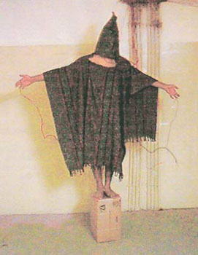
The ethics of torture

Slide 20
Political commitment and the ethics of the Act
Why should political passion be restricted to the Right and to religious fundamentalists? The Left must become politically engaged once again
A new kind of militant politics in which economic struggles over global capitalism are central
The only way global capitalism can be transformed is to question its political and ideological framework/coordinates – ie liberal democracy.
Zizek invokes the communist politics of revolution, and the figure of Lenin as a symbol of political commitment and dedication.
Ethics of the Act – acting before it is even possible to act, making a kind of impossible choice, after which the conditions of possibility are created retroactively.
  In politics, sometimes it is possible, and indeed necessary, to do the impossible – to make bold, even seemingly utopian moves. Miracles do happen in politics.

Slide 21
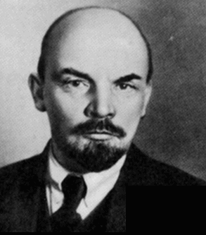
Does Lenin provide a model for radical political commitment today?

